Slide 1
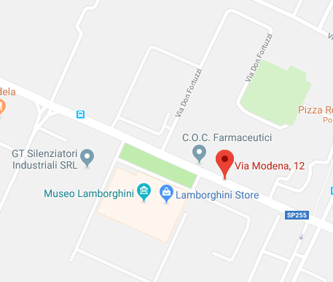
GeoLocation and GoogleMaps API

Slide 2
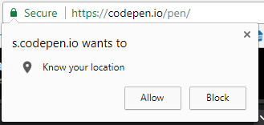
Location services
HTML5 comes with native JavaScript support through browser capabilities to identify the client location.
https://developer.mozilla.org/en-US/docs/Web/API/Geolocation
The JavaScript GeoLocation class has useful methods such as getCurrentPosition() and watchPosition()
Users must allow the browser to access their location when then enables the JavaScript methods

Slide 3
Location services
The geolocation object
The geolocation API is published through the navigator.geolocation object.
If the object exists, geolocation services are available. You can test for the presence of geolocation by (not actual JS code):
if ("geolocation" in navigator) { /* geolocation is available */ } else {
/* geolocation IS NOT available */ }

Slide 4
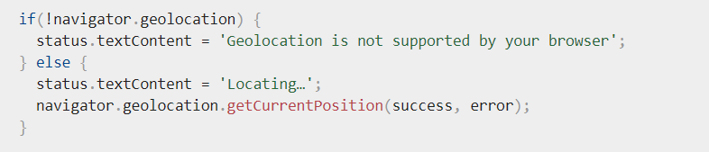
The geolocation object
Typical implementation for the check:
Success and error are programmer defined functions called in case success (getting the current position) or error (e.g. user refusal in the browser)
https://developer.mozilla.org/en-US/docs/Web/API/Geolocation_API

Slide 5
Location services
To obtain the user's current location, you can call the getCurrentPosition() method.
This initiates an asynchronous request to detect the user's position, and queries the positioning hardware to get up-to-date information.
When the position is determined, the defined callback function is executed. You can optionally provide a second callback function to be executed if an error occurs.

Slide 6
Location services
By default, getCurrentPosition() tries to answer as fast as possible with a low accuracy result. It is useful if you need a quick answer regardless of the accuracy.
Devices with a GPS, for example, can take a minute or more to get a GPS fix, so less accurate data (IP location or wifi) may be returned to getCurrentPosition().
Simple example:
navigator.geolocation.getCurrentPosition(function(position) { do_something(position.coords.latitude,position.coords.longitude); } );

Slide 7

Exercise 18.1
Write a HTML test file containing the test code on previous slid and if the GeoLocation class exists find and display the users location as text like this:
Put your JavaScript in a <script> element and it will execute when you load the HTML file.

Slide 8
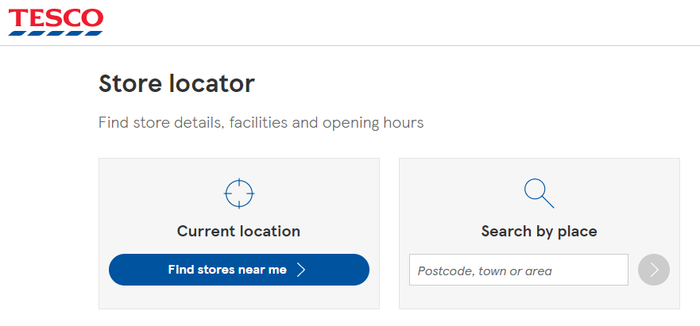
Exercise 18.2
Try incorporating your solution into you semester 1 work at the point where location is important . Find location of user
This can then be used to enhance your search feature for example by adding search by location (using a custom GoogleMap or OpenStreetmap – see later in this workshop)
UI control to trigger location service lookup which then posts the position back to the server to perform a search based on location.

Slide 9

Exercise 18.3 PHP, JS and MVC…
MVC hasn’t gone away!
Design a PHP helper class that produces the necessary JavaScript code to give your pages location capabilities. The class needs methods that return JavaScript blocks that you can inject into the $view object into a suitable placeholder in the head or body areas. E.g. in a PHP controller:
LocationClass loc = new LocationClass;
$view->location = loc.getLocationCode();
. . . And in the view, something like:
<head><php echo $view->location;?></head>

Slide 10

Exercise 18.3 PHP, JS and MVC…
LocationClass needs methods to output JavaScript such as
// green below 👇 is pseudocode not JavaScript
function getLocationCode() { var code = 'if ("geolocation" in navigator) {/*geolocation available */ navigator.geolocation.getCurrentPosition(function(position) { do_something(position.coords. latitude,position.coords.longitude); });} else {/* geolocation IS NOT available */ }'; return code; }
This way, you can manage your geo location implementation code independently of your pages. It’s more brainwork but encapsulation like this is good software engineering.
/

Slide 11

Exercise 18.3 PHP, JS and MVC…
Of course you could write a series of JavaScript functions in an external .js file just include them when you need them.
It’s an alternative approach and is acceptable but doesn’t give you quite the same level of programmatic control over what is in included in your views.
It’s similar to including other libraries like jQuery where the whole library is downloaded by the browser even though only a few parts of it might only ever get used.
Always think about page weight!
kB

Slide 12
Exercise 18.4 further GeoLocation
Read through the following page and you will see that you can handle GeoLocation errors
https://developer.mozilla.org/en-US/docs/Web/API/Geolocation/Using_geolocation
Location errors are handled through a callback function, if provided when calling getCurrentPosition() with:
navigator.geolocation.getCurrentPosition(success, error);
error: An optional callback function that takes a PositionError object as its parameter.
function errorCallback(error) { alert('ERROR(' + error.code + '): ' + error.message);
};
Try this out by adding it to your previous examples

Slide 13
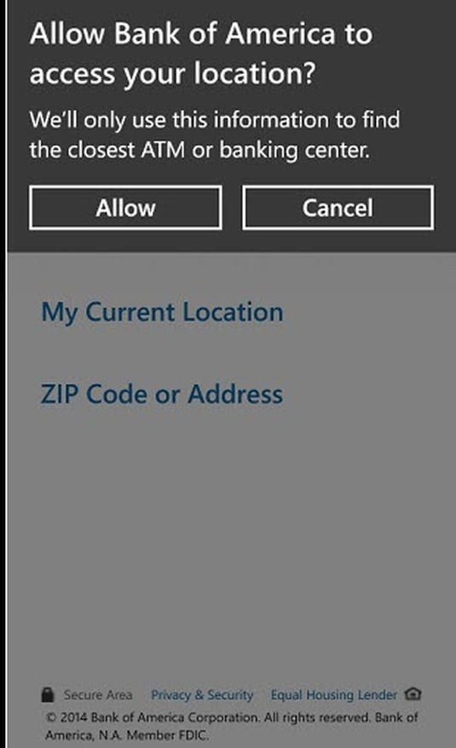
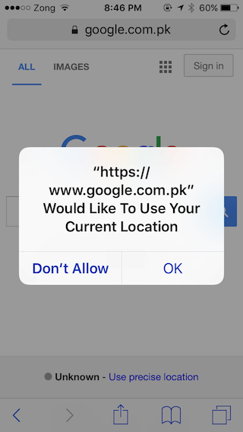
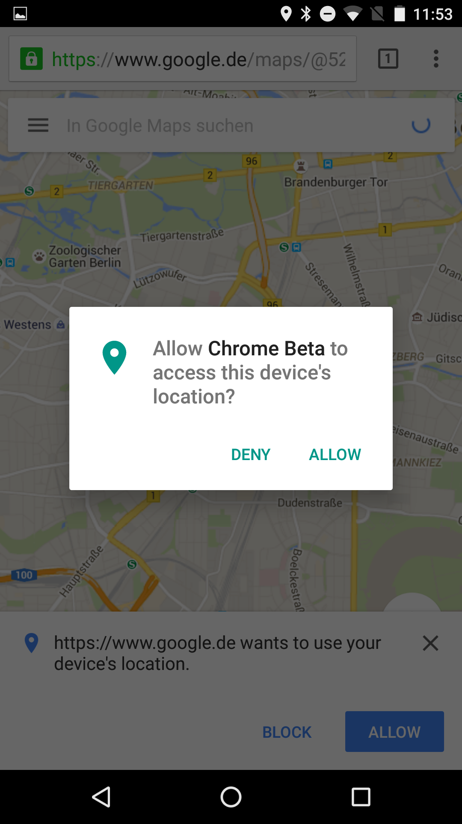
Exercises 18.1 – 18.4
Don’t forget to test on mobile browsers as some may not fully implement the GeoLocation features.

Slide 14
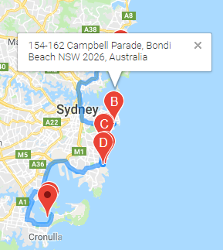
Maps AP
You’ve used Google Maps or other map APis, you’ve probably embedded a map into a website, but using JavaScript (and other languages) you can do much more using their API directly from your application.
You can do things like:
Define a custom map view
Add markers and add information windows to the markers
Add routing between markers

Slide 15

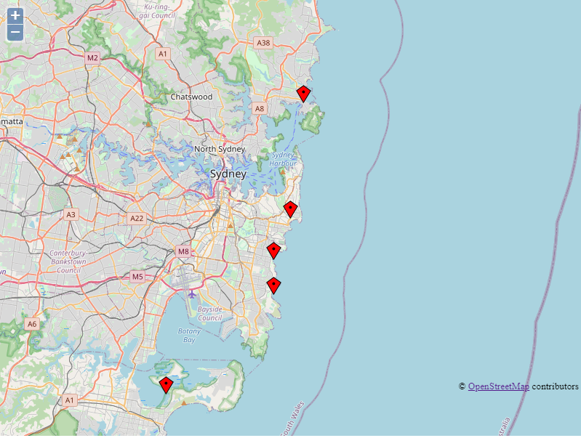
You don’t have to use GoogleMaps. OpenStreetMap is available, is free and well supported in terms of detail
– perhaps has more detail than GoogleMaps because it is partly crowd sourced (anyone can add things a bit like Wikipedia)
Notes:
https://www.youtube.com/watch?v=gnj3wK381ew
https://openlayers.org/en/latest/doc/tutorials/concepts.html

Slide 16
OpenLayers makes it easy to put a dynamic map in any web page. It can display map tiles, vector data and markers loaded from any source. OpenLayers has been developed to further the use of geographic information of all kinds. It is completely free, Open Source JavaScript, released under the 2-clause BSD License (also known as the FreeBSD).
It can show different types of geo data https://openlayers.org/
Notes:
https://www.youtube.com/watch?v=gnj3wK381ew
https://openlayers.org/en/latest/doc/tutorials/concepts.html

Slide 17
JavaScript library is needed to add OpenStreetMap to your website. OpenStreetMap (OSM) is an open-source map data platform that provides map data and services to various applications, and it is not built specifically for web development.
To use OpenStreetMap on your website, you can use a JavaScript library called Leaflet or MapBox, which are popular open-source library for interactive maps.
Leaflet is easy to use and has many plugins available that can extend its functionality. Mapbox offers a more comprehensive set of tools for working with maps but also has a steeper learning curve.
Using a JavaScript library like Leaflet allows you to easily add interactive maps to your website, customize them to fit your needs, and incorporate other features like markers, layers, and popups.

Slide 18
Mapbox Account
Sign up for a Mapbox account: Go to the Mapbox website and sign up for a free account. You'll need to provide some basic information, such as your name and email address.
Create a new Mapbox map: Once you've signed up for an account, you can create a new map in the Mapbox Studio. You can customize your map by adding layers, markers, and other features.
Generate an access token: To use your map on your website, you'll need to generate an access token. Go to your Mapbox account dashboard and click on the "Access tokens" tab. Generate a new access token and copy it to your clipboard.

Slide 19
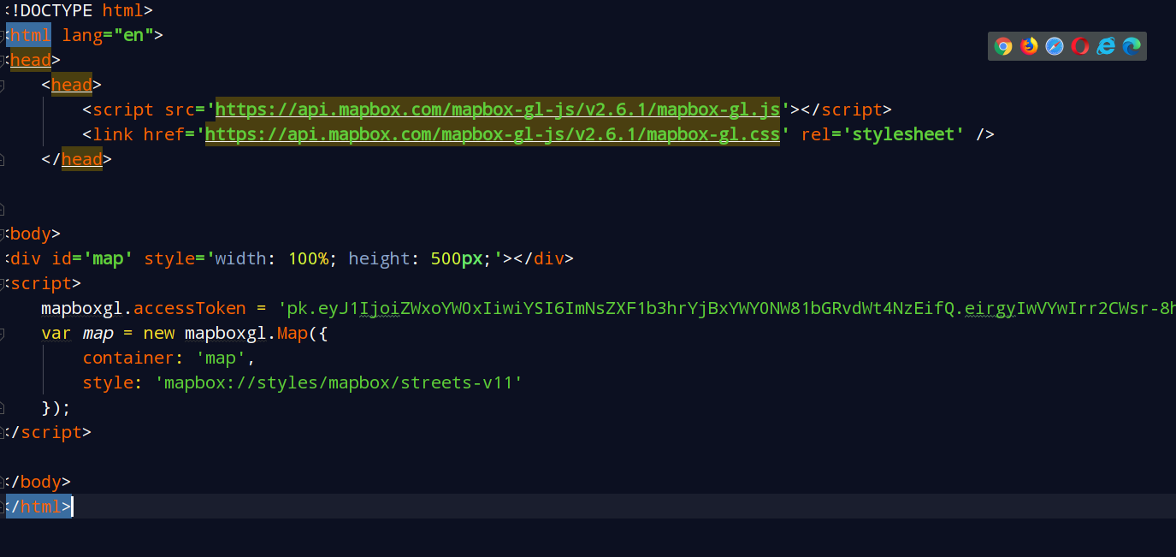

Slide 20
Leaflet
Download Leaflet: First, download the Leaflet library from the Leaflet website. You can either download the source code and include it in your project or use a CDN link.
Include Leaflet in your HTML file: Add the Leaflet JavaScript and CSS files to your HTML file using the following code:
<head>
<link rel="stylesheet" href="https://unpkg.com/leaflet@1.7.1/dist/leaflet.css" integrity="sha384-q3luZuepS27S+Y6MYfIM+vNzPHRE+LyX9Jc+mv1WFLg1Bt+Z6oK2QDb8Nw+BoPQ/" crossorigin=""/>
<script src="https://unpkg.com/leaflet@1.7.1/dist/leaflet.js" integrity="sha384-H/fy31EjX9+0rn8Oq/dRQ2PaNUgZWaBsp/eO8wYc/w1gV7Whqxpo9QBYV7Wqr+jE" crossorigin=""></script>
</head>

Slide 21
Add these lines of code to your script file
var mymap = L.map('map').setView([51.505, -0.09], 13);
L.tileLayer('https://{s}.tile.openstreetmap.org/{z}/{x}/{y}.png', {
attribution: 'Map data &copy; <a href="https://www.openstreetmap.org/">OpenStreetMap</a> contributors',
maxZoom: 18
}).addTo(mymap);
To add pin to map

Slide 22
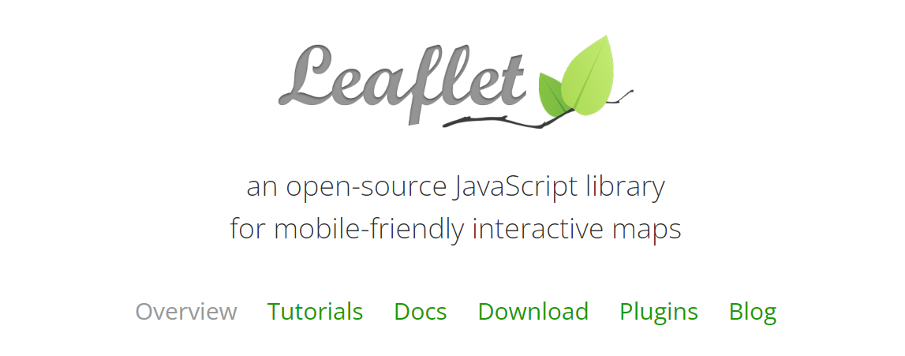
Leaflet Liberary
Two options:
CDN
Download (preferred)

Slide 23
Leaflet Liberary
Two options:
CDN
Download (preferred)

Slide 24
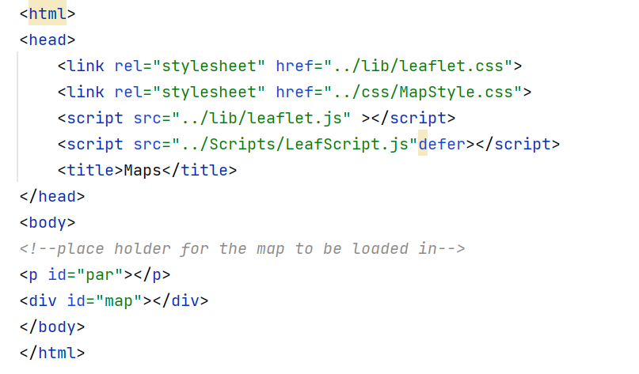
First: Prepare your View
Your css only including height
Your JavaScript that has the map set up

Slide 25
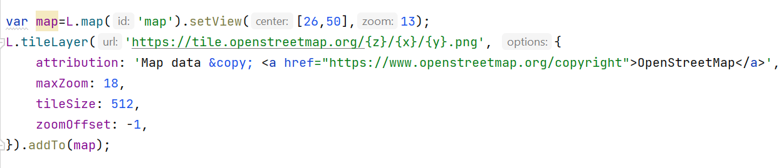
Second: to set up your map, your Javascript needs to have the following code
Call your View in the Controller and you should be presented with your map

Slide 26
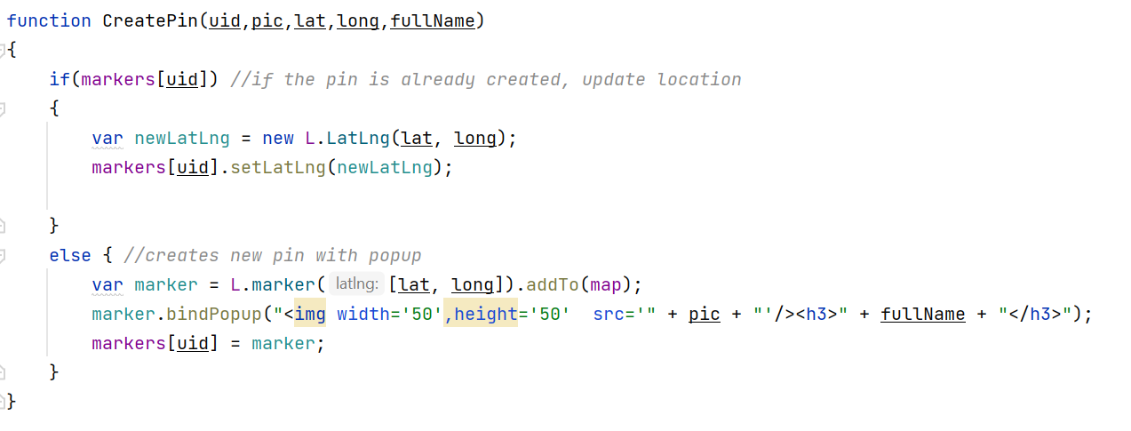
Create Pins

Slide 27
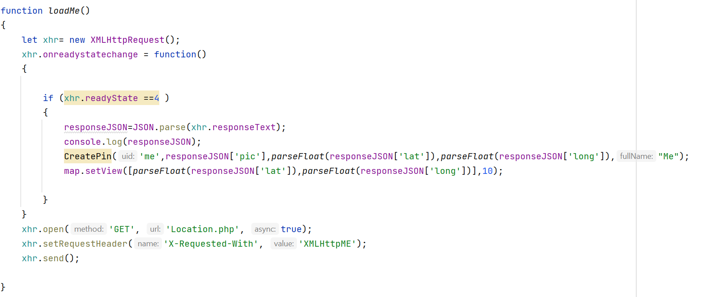
Third: add the functions to load different location

Slide 28
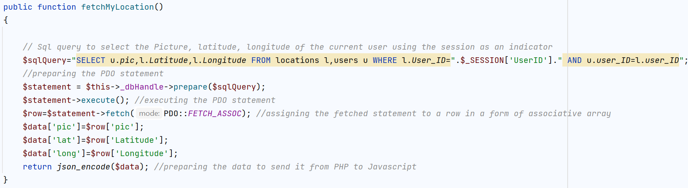
In controller:
In Model:

Slide 29
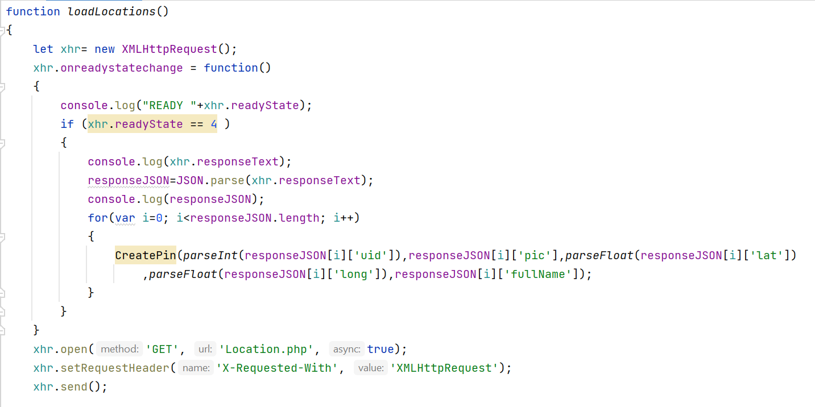
Load locations of friends:

Slide 30
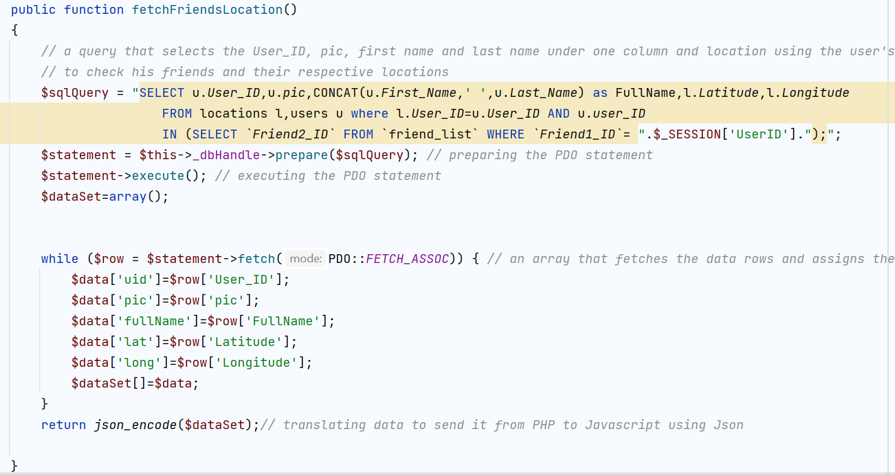

Slide 31
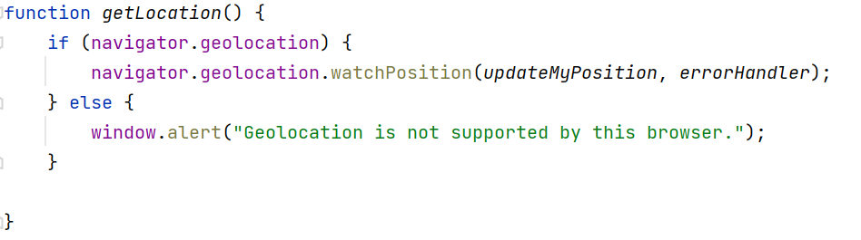
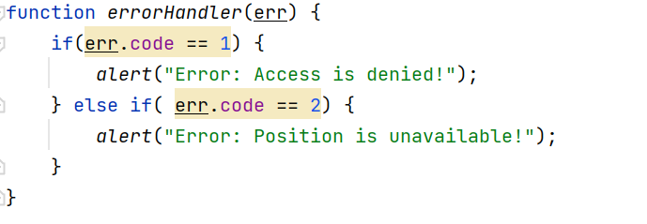
Fourth: create a geolocation function
You will pass the watchPosition method the success function and the error handling function

Slide 32
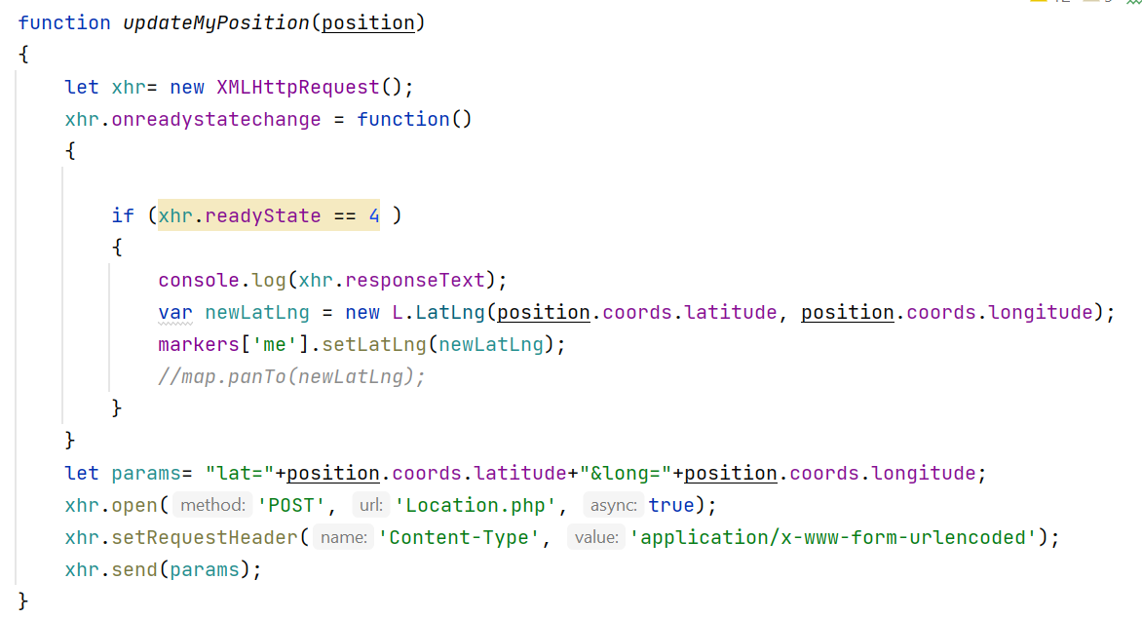
Success case passed to geolocation:

Slide 33
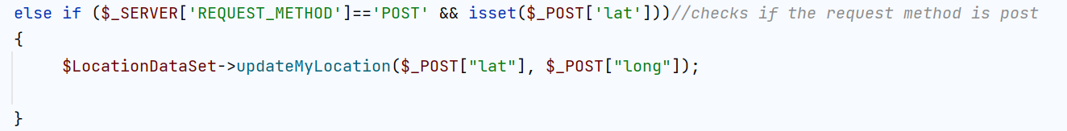
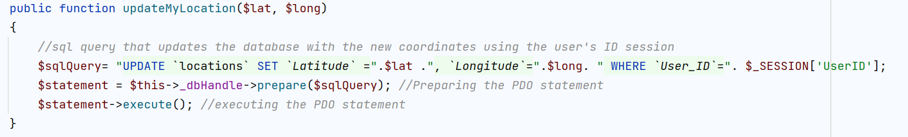
In the Controller, add:
In the model you need to update the Lat/Long:

Slide 34
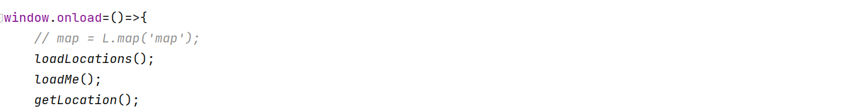
Call the functions when the window loads in your JS

Slide 35
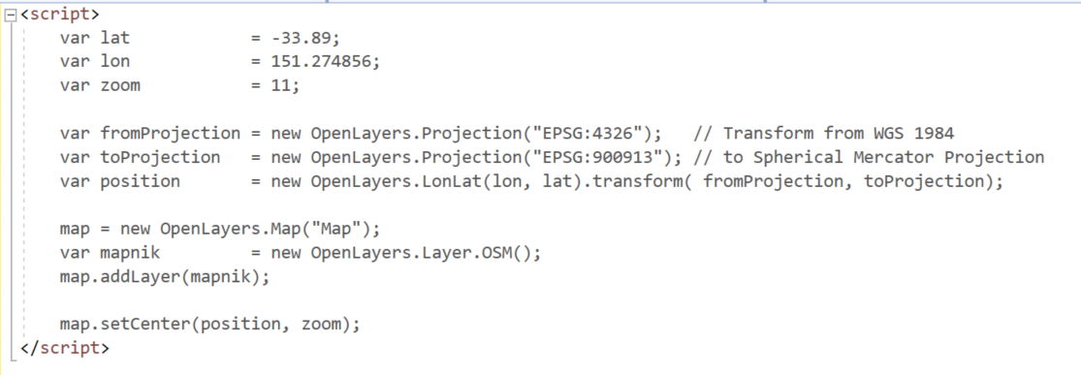
OpenStreeMaps and OpenLayers
The following example is done by using open street 2
Then this basic test script will create a new map object and centre it on the coordinates given

Slide 36
Layers and markers
. . .
<script src="OpenLayers-2.13.1/OpenLayers.js"></script>
<script>
var locations = [
['Manly Beach', -33.80010128657071, 151.28747820854187, 2],
['Bondi Beach', -33.890542, 151.274856, 4],
['Coogee Beach', -33.923036, 151.259052, 5],
['Maroubra Beach', -33.950198, 151.259302, 1],
['Cronulla Beach', -34.028249, 151.157507, 3]
];
. . .
You can add markers from a list of data, same as the GoogleMaps example. First add the array at the top of the script.

Slide 37
Layers and markers
map = new OpenLayers.Map("Map");
var mapnik = new OpenLayers.Layer.OSM();
map.addLayer(mapnik);
// http://dev.openlayers.org/docs/files/OpenLayers/Marker-js.html
// make a marker layer
var markers = new OpenLayers.Layer.Markers("Markers");
map.addLayer(markers);
//markers.addMarker(new OpenLayers.Marker(position));
locations.forEach(createMarker)
function createMarker(item, index) {
// create a marker from the data
let mposition = new OpenLayers.LonLat(item[2], item[1]). transform(fromProjection, toProjection);
// place marker on the map layer
markers.addMarker(new OpenLayers.Marker(mposition));
}
Then you create a marker layer and create Markers at the given LonLat positions by looping through the data array with a forEach;

Slide 38
Layers and markers
Complete standalone example with markers from an array
<!DOCTYPE HTML>
<html>
<head>
<title>OpenLayers Simplest Example</title>
</head>
<body>
<div id="Map" style="width:800px;height:600px"></div>
<script src="OpenLayers-2.13.1/OpenLayers.js"></script>
<script>
var locations = [
['Manly Beach', -33.80010128657071, 151.28747820854187, 2],['Bondi Beach', -33.890542, 151.274856, 4],['Coogee Beach', -33.923036, 151.259052, 5], ['Maroubra Beach', -33.950198, 151.259302, 1],['Cronulla Beach', -34.028249, 151.157507, 3]
];
var lat = -33.89;
var lon = 151.274856;
var zoom = 11;
var fromProjection = new OpenLayers.Projection("EPSG:4326"); // Transform from WGS 1984
var toProjection = new OpenLayers.Projection("EPSG:900913"); // to Spherical Mercator Projection
var position = new OpenLayers.LonLat(lon, lat).transform( fromProjection, toProjection);
map = new OpenLayers.Map("Map");
var mapnik = new OpenLayers.Layer.OSM();
map.addLayer(mapnik);
// http://dev.openlayers.org/docs/files/OpenLayers/Marker-js.html
// make a marker layer
var markers = new OpenLayers.Layer.Markers( "Markers" );
map.addLayer(markers);
locations.forEach(createMarker)
function createMarker(item,index)
{
// show the data in the console
console.log(item[0],item[2], item[1]);
// create a marker from the data
let mposition = new OpenLayers.LonLat(item[2], item[1]).transform( fromProjection, toProjection);
// place marker on the map layer
markers.addMarker(new OpenLayers.Marker(mposition));
}
map.setCenter(position, zoom);
</script>
</body>
</html>

Slide 39
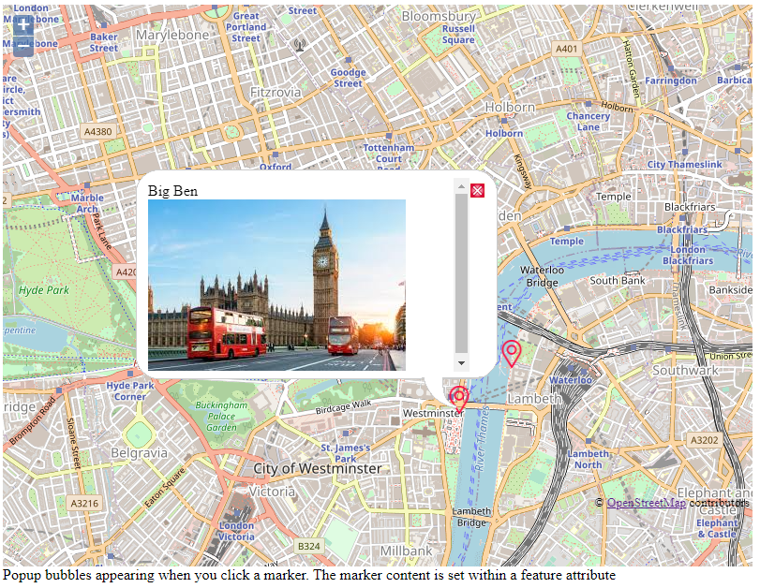
Markers with info box
Now you can add a popup layer to each marker and it can contain HTML/CSS. The popup appears when a user clicks the marker. Based on this example: https://harrywood.co.uk/maps/examples/openlayers/marker-popups.html

Slide 40
Markers with info box
Now you can add a popup (vector) layer feature to each marker and it can contain HTML/CSS. The popup appears when a user clicks the marker.
// create an overlay
var vectorLayer = new OpenLayers.Layer.Vector("Overlay");
// Define markers as "features" of the vector layer:
var feature = new OpenLayers.Feature.Vector(
new OpenLayers.Geometry.Point(-0.1279688,51.5077286)
.transform(epsg4326, projectTo),
{ description: 'This is the value of<br>the description attribute.' + '<img src="images/nelson.jpg">' },
{ externalGraphic: 'marker.png', graphicHeight: 30, graphicWidth: 30, graphicXOffset: -12, graphicYOffset: -25 }
);
vectorLayer.addFeatures(feature); // add the feature
Create a new feature at position
Define the content of the popup
Custom marker graphic and details

Slide 41
Markers with info box
Adding the click selection controls
//Add a selector control to the vectorLayer with popup functions
var controls = {
selector: new OpenLayers.Control.SelectFeature(vectorLayer, { onSelect: createPopup, onUnselect: destroyPopup })
};
function createPopup(feature) {
feature.popup = new OpenLayers.Popup.FramedCloud("pop",
feature.geometry.getBounds().getCenterLonLat(),
null,'<div class="markerContent">' + feature.attributes.description + '</div>',null,true,
function () { controls['selector'].unselectAll(); });
map.addPopup(feature.popup);
}
function destroyPopup(feature) {
feature.popup.destroy();
feature.popup = null;
}
map.addControl(controls['selector']);
controls['selector'].activate();
Adding selection processing functions
Define popup
Clean up when closed
Actually add the controls to the map

Slide 42
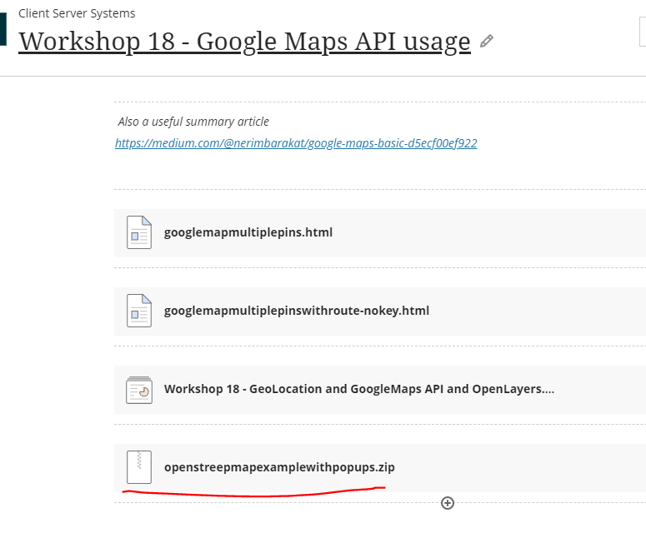
Markers with info box
Full working demo for the popup box example discussed is on Blackboard

Slide 43
Markers with info box
Now you need to integrate your chosen mapping feature into your system Views.
The php code needs to generate the JS data set dynamically into the view code sent to the browser e.g. (for the simple markers example)
$script = “var locations = [“;
foreach ($view->ItemsDataSet as $ItemData) {
$script = $script . “['” . $ItemData->getlocationName() . “',” . $ItemData->getlocationLong() . “,” . $ItemData->getlocationLat() . “],”;
}
$script = rtrim($script, “,”); // remove the last unnecessary comma
$script = $script . “];”; // add on the closing bracket
echo $script; // output to the browser
// to produce JS array code in the exact format in the View:
var locations = [
['Manly Beach', -33.80010128657071, 151.28747820854187],
['Bondi Beach', -33.890542, 151.274856],
['Coogee Beach', -33.923036, 151.259052],
['Maroubra Beach', -33.950198, 151.259302],
['Cronulla Beach', -34.028249, 151.1575073]
];
You need location data in your DB, you need to extend your models to have location accessor functions.

Slide 44
Markers with info box
Now you need to integrate your chosen mapping feature into your system Views.
The php code needs to generate the JS data set dynamically into the view code sent to the browser e.g. (for the simple markers example)
$script = “var locations = [“;
foreach ($view->ItemsDataSet as $ItemData) {
$script = $script . “['” . $ItemData->getlocationName() . “',” . $ItemData->getlocationLong() . “,” . $ItemData->getlocationLat() . “],”;
}
$script = rtrim($script, “,”); // remove the last unnecessary comma
$script = $script . “];”; // add on the closing bracket
echo $script; // output to the browser
// to produce JS array code in the exact format in the View:
var locations = [
['Manly Beach', -33.80010128657071, 151.28747820854187],
['Bondi Beach', -33.890542, 151.274856],
['Coogee Beach', -33.923036, 151.259052],
['Maroubra Beach', -33.950198, 151.259302],
['Cronulla Beach', -34.028249, 151.1575073]
];
You need location data in your DB, you need to extend your models to have location accessor functions.

Slide 45
Markers with info box
Similarly if you use the Markers with popup info box then you need to generate the content whilst echo’ing out JS e.g.
. . .
foreach ($view->ItemsDataSet as $ItemData) {
$script = “var feature = new OpenLayers.Feature.Vector(
new OpenLayers.Geometry.Point(”;
$script = $script . $ItemData->getlocationLong() . “,”;
$script = $script . $ItemData->getlocationLat() . “)”;
$script = $script . “.transform(epsg4326, projectTo),{ description: ‘” . $ItemData->getlocationName() . ”' + '<img src="images/nelson.jpg">’ },”;
$script = $script . “{ externalGraphic: 'marker.png', graphicHeight: 30, graphicWidth: 30, graphicXOffset: -12, graphicYOffset: -25 } );
vectorLayer.addFeatures(feature);”;
echo $script; // echo out constructed JS code
JS code that we need to inject values in from the hp dataset
$script will be a perfectly formed JS code snippet with generated values.

